Slide 1
Although maybe not a ‘priority’ the differences in the interactions b/w EGC and each shore crab spp. are interesting. Unfortunately confounded by substrate.
In addition to predation, observed a lot of apparent antagonistic interactions too (ie. non-lethal attacks = competition?).
Given Grosholz’s long term data set and limited work by Jensen, and observations by Patty et al. I think there is a lot to do on EGC/shore crab interactions. If not for this CSRF, then to maintain place in bio-con Lab A and do continued animal research on station.
COULD fall under CSRF is we think shore crabs are a viable indicator though (re. Grosholz)
Sand
Varnish clam
Japanese littleneck clam
Hairy shore crab
Mussels (on rocks)
Cobble
Dire whelk
Hermit crab
Purple shore crab
Isopods

Slide 2
Experimental design
Crab # | Prey | Eaten
EGC-01 | Jpn. littleneck | 1
EGC-01 | Isopods | 0
EGC-01 | Clam worms | 1
EGC-01 | Hermit crabs | 1
EGC-01 | Varnish clam | 1
EGC-01 | Shore crabs | 0
EGC-02 | Jpn. littleneck | 1
EGC-02 | Isopods | 0
EGC-02 | Clam worms | 0
EGC-02 | Hermit crabs | 0
EGC-02 | Varnish clam | 1
EGC-02 | Shore crabs | 1
GRA-Lg01 | Jpn. littleneck | 0
GRA-Lg01 | Isopods | 1
GRA-Lg01 | Clam worms | 1
GRA-Lg01 | Hermit crabs | 0
GRA-Lg01 | Varnish clam | 0
GRA-Lg01 | Shore crabs | 0
EGC
(n = 20)
Jpn. littleneck
Isopods
LG
(n = 20)
Clam worms
400+ trials
later…
Hermit crabs
Varnish clam
SM
(n = 20)
Shore crabs
etc… (n = 10 spp)
Each individual crab sees each prey ONCE. Fully independent w/in prey type
Also collected

Slide 3
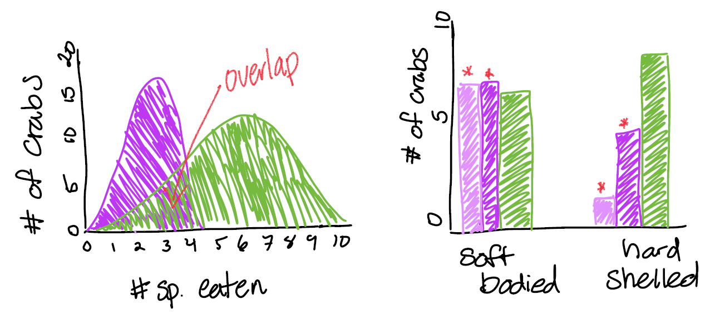
Hypothesized results

Slide 4
Most crabs were not offered all 7 species though (died, etc.)

Slide 8
Summer Lab Exp.

Slide 9
PBS space available (probably)
12 small bins in Bio Con Lab A (~0.25 m2)
Must use space for trials, fasting, and crab animal holding – so limited number of crabs at a time.
Going to plan with the assumption I can use 6 bins for trials and 6 bins for holding/fasting
Some amount of sea table space in courtyard for prey (must be collected locally)
Assume May to mid-July?
From VIU exps. – focus on Japanese littlenecks (yes?)
But also, what about the mud shrimp, varnish clam, or untested clams? Prey choice experiments?
O/T for weekend work!

Slide 10
Staged Experiments on JPL x EGC interactions
1. Crab/clam size relationships
Basically a refinement of VIU clam exp.
Each bin gets n clams of small, medium, and large + 1 EGC (need a range of sizes)
Record with Go-Pros if possible for actual attack and handling times
If doing exp #3 (prey preference) then do any additional clam species (i.e. varnish)
This way all future exps are run with the ideal prey size.
Which species? JPL at least.

Slide 11
Staged Experiments on JPL x EGC interactions
2. Clam burial depth in response to EGC presence
Clams in sufficient sand w/ fishing line superglued to shell to measure burial depth
W/ and w/o a non-feeding EGC present (in a small container w/ holes)
Possible additional treatment of native crab (Dungeness preferably)?
Possible additional treatment of adding a clam to container so crabs can feed
Possible additional treatment of varnish clams

Slide 12
Staged Experiments on JPL x EGC interactions
2. Prey choice (optional)
Confirm preference for JPL at least vs. varnish clams
Single crab with 3 (?) each of appropriately sized clams
Observe until first successful predation event only

Slide 13
Staged Experiments on JPL x EGC interactions
4. Interference competition (optional or pilot)
Precursor to field exp. using 1-3 crabs (MAX) per bin
Allows us to compare lab and field results
Can pilot some of the methods before working against tides
E.g. clam baskets?
IF we want to test native species too, do here in lab (as Dungies won’t handle low tide exposure well)
4 weeks

Slide 14
Summer Field Exp.

Slide 15
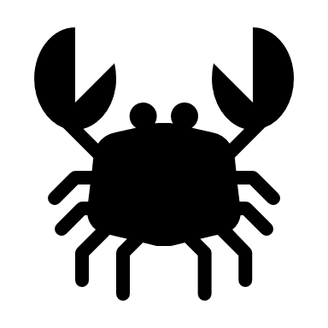

Field Experiment
Priority: per capita impact of EGC on clam abundance
Additional: as above, but including different clam densities
Not crazy about testing native spp. due to exposure at low tide
Enclosures: 0.25 m2 at a minimum (match lab) – bigger means larger range of density treatments though
Full cube, with opening on top
Could we modify the ones we have? Put 4 together and cut sides open?
4 EGC densities X 4 clam densities X 6 reps = 96 trials
Big question is – where are we getting clams? Do we need to bring them in and if so is that valid?

Slide 16
Low tide weeks
July 12-17 (-0.1 to 0.2)
July 25-31 (0.4 – 0.6)
August 10-14 (0.0 – 0.2)
Aug 26-29 (0.5-0.6)
However, can use waders to do some work when tide is coming in, perhaps? Would be great if clam baskets worked here.
- Day 1: deploy clams
- Day 2: deploy crabs
- Day 3: leave alone (optional, use lab exp. to inform duration)
- Day 4: retrieve and reset if basket idea works
96 trials / 16 enclosures = 6 rotations
6 rotations @ 4 days per = 24 field days min.
Perhaps staggered rotation?
Consider (track) soak time and include in analysis

